Slide 1
DO NOW 1.Define the independent, dependant and extraneous variables 2. What does the term operationalize mean? 3. What is the difference between experimental and non-experimental research? 4. Name and describe 4 ways of data collection
Reminders:
Phones away
Bags on floor
Books out
Pens out
Whiteboard

Slide 2
Do Now Answers
IV = Manipulated DV = Measured EV = may impact results so try to control
To make a construct specific and measurable
Experimental = tests cause and effect has an IV and Dv.
Non-Experimental = measuring the relationship of two variables
Survey, Interview, Observation, Case Study
Survey – Series of open and closed questions requiring a written response by participants
Interview – Series of open and closed questions requiring a verbal response by participants
Observations – 2 or more researchers watch and either tally behaviours and code them or describe the behaviours through a report
Case Study – where one phenomena or person is looked at in great detail using multiple methods of data collection ( surveys, brain scans, observations etc)

Slide 3
DO NOW
 | Convenience sampling | Volunteer sampling | Stratified sampling
How are the participants selected?
Advantages of the method
Disadvantages of the method

Slide 4
Identify a weakness of random sampling
Activate prior learning

Slide 5
What are some other designs when planning research in psychology
Activate prior learning

Slide 6
Define extraneous variable
Activate prior learning

Slide 7
RESEARCH METHODS
Syllabus points:
Participant rights and the role of the researcher
Sources of error in research
Evaluating research

Slide 8
Why do researchers conduct research?
What topics would you want to research?
Be prepared to share

Slide 9
What terms are used to evaluate a piece of research?

Slide 10
What do we know about the terms: evaluation, reliability, validity and accuracy? Think, Pair, Share – on your whiteboard write the key words that come to mind
Activate prior knowledge

Slide 11
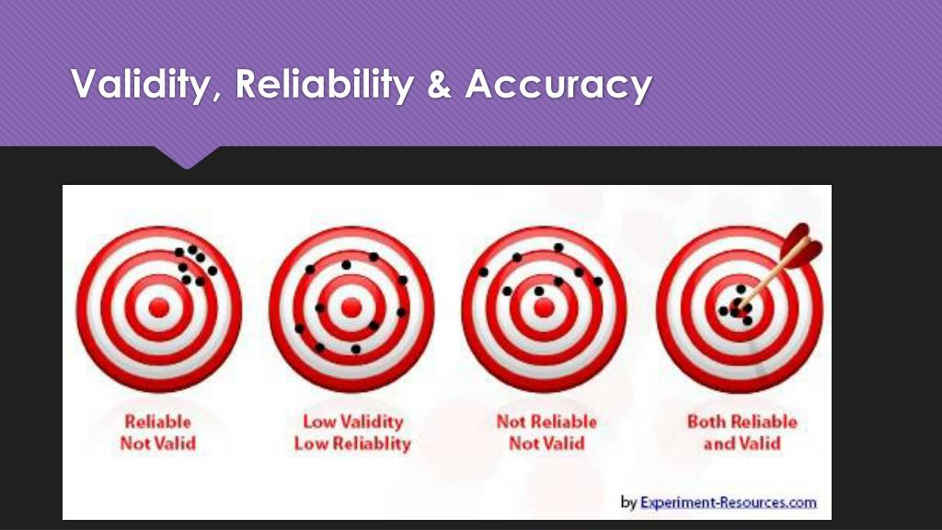
Key terms
Tip to remember
Reliability: replicable or repeatable Validity: variables (were they controlled well?
Reliability: high or low
Consistency of the results. Can you replicate the study and get the same result.
Validity: high or low
Did the test measure what it was intended to measure. Was the test a good measure of reaction time?
Accuracy:
How close the measurement is to the expected value
Concept Development

Slide 12
Experiments - controlling variables
Activate prior learning
To ensure that it is the IV effecting the DV
Extraneous variables – Any variable that could effect the DV and therefore effects the reliability of the results if left uncontrolled
Confounding variables – Any variable left uncontrolled that does effect the DV and therefore effects the reliability of the results
If there are many confounding variables the research lacks validity.

Slide 13
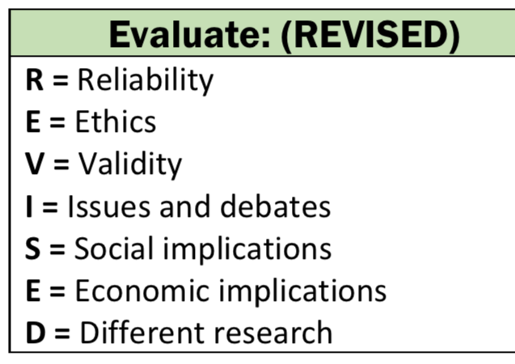
Evaluating research
You do not need to cover all of these points to evaluate a piece of research –
Read the question and see what it is specifically asking you to evaluate in the research
Evaluating research
Generalisability to target population
Reliability
Validity
Ethics
Methodological flaws
Comparing to past research

Slide 14

Evaluating research
Generalisability to the population
Definition:
a measure of how well a researcher thinks their experimental results from a sample can be extended to the population as a whole.
A researcher often cannot test the whole target population, instead the take a sample of the population and infer the results from this smaller sample to the whole target population.
It is important that the sample is representative of the whole target population i.e there is no sample bias.
To do this / to evaluate whether a piece of research has high generalizability - look at their sample and sample method
Definitions
Infer: conclude (something) from evidence. Representative: a representative sample is a subset of a population that accurately reflect the characteristics of the larger group. Sample Bias: the sample has some members of the intended population which are over-represented or under-represented.

Slide 15

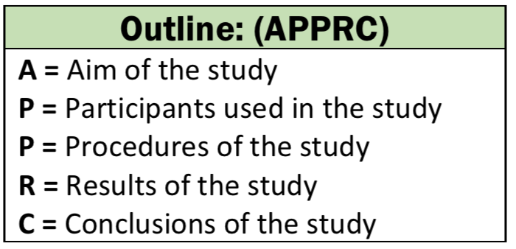
Practice
Research one of the following studies:
The monster study - Johnson The Schacter and Singer Experiment on Emotion
Or Car Crash Experiment – Loftus and Palmer
1. Outline what happened:
2. Evaluate the research by discussing one of the following:

